Slide 1

STUDENT DETAILS
NAME: UDAY KUMAR J B
SKILLS BUILD EMAIL ID: UDAYKUMARJB1999@GMAIL.COM
COLLEGE NAME: SJC INSTITUTE OF TECHNOLOGY
CHICKBALLAPUR
COLLEGE STATE: KARNATAKA
INTERNSHIP DOMAIN AND INTERNSHIP START AND END
DATE:
[AI ( ARTIFICIAL INTELLIGENCE)]/[07/06/2023 - 24/07/2023 ]

Slide 2
PROJECT TITLE/PROBLEM STATEMENT
PROJECT TITLE:
MENTAL FITNESS TRACKER
PROBLEM STATEMENT:
Develop a mental fitness tracker that addresses the growing concern of mental well-being.
The tracker should provide real-time monitoring and analysis of key indicators such as mood, stress levels, sleep quality, and productivity.
It should offer personalized recommendations and strategies to improve mental health, promoting self-awareness and proactive self-care.
The goal is to empower individuals to track and manage their mental fitness effectively.

Slide 3
AGENDA
Real-time monitoring: The mental fitness tracker will continuously monitor and record important indicators of mental health, such as mood, stress levels, sleep quality, physical activity, and social interactions.
Comprehensive analysis: It will employ advanced algorithms and data analytics to analyze the collected data and generate insightful reports, identifying patterns, trends, and potential triggers that affect mental well-being.
Personalized recommendations: Based on the analysis, the tracker will provide personalized recommendations and strategies to improve mental fitness. This may include suggestions for stress management techniques, mindfulness exercises, sleep hygiene practices, and other evidence-based interventions.
Goal setting and progress tracking: Users will be able to set mental health goals and track their progress over time. The tracker will provide visual representations and milestones to help individuals stay motivated and engaged in their mental fitness journey.

Slide 4
AGENDA
Integration with wearable devices: The mental fitness tracker will seamlessly integrate with popular wearable devices, such as smartwatches or fitness trackers, to capture additional relevant data points, including heart rate variability, physical activity levels, and sleep patterns.
Mindfulness and meditation features: The tracker will offer guided mindfulness and meditation exercises, promoting relaxation, stress reduction, and emotional well-being. These features will be customizable to suit different preferences and skill levels.
Social support and community engagement: The tracker will include social support features, such as the ability to connect with friends, share achievements, and join mental health-focused communities. This will encourage peer support, fostering a sense of belonging and reducing feelings of isolation.

Slide 5
PROJECT OVERVIEW
The mental fitness tracker project aims to develop a comprehensive solution for monitoring and improving mental well-being. It will involve the creation of a mobile application that integrates with wearable devices and collects data on various indicators such as mood, stress levels, sleep quality, and physical activity.
The collected data will be analyzed using advanced algorithms to generate personalized insights and recommendations for the user.
The application will also include features for goal setting, progress tracking, and guided mindfulness exercises. Integration with social platforms will enable users to connect with peers and access a supportive community.
The project will prioritize user privacy and data security, ensuring that all information is handled confidentially.
User feedback and iterative testing will be conducted to continually enhance the user experience and effectiveness of the mental fitness tracker.
The ultimate goal is to empower individuals to take proactive steps towards managing their mental health and improving their overall well-being.

Slide 6
WHO ARE THE END USERS OF THIS PROJECT?
The end users of the mental fitness tracker can include individuals of various age groups who are concerned about their mental well-being and interested in actively monitoring and improving their mental health.
This can encompass a wide range of individuals, such as students, working professionals, athletes, caregivers, and anyone else who prioritizes their mental fitness.
The tracker can cater to people experiencing stress, anxiety, or other mental health challenges, as well as those seeking to maintain and enhance their existing mental well-being.
It is designed to be user-friendly and adaptable, allowing individuals from different backgrounds and with varying levels of technological proficiency to benefit from its features.

Slide 7
YOUR SOLUTION AND ITS VALUE PROPOSITION
Mental fitness tracker: A cutting-edge solution that monitors and tracks your mental well-being and offers valuable insights for personal growth.
Real-time data: Continuously collects data on your mood, stress levels, sleep patterns, and other relevant metrics, providing a comprehensive view of your mental state.
Personalized recommendations: Analyzes the collected data to generate personalized recommendations, such as relaxation techniques, mindfulness exercises, or self-care activities tailored to your specific needs.
Goal setting and progress tracking: Helps you set achievable mental health goals and tracks your progress over time, empowering you to make positive changes and celebrate milestones.
Emotional awareness: Increases your self-awareness by identifying patterns and triggers that affect your mental well-being, allowing you to proactively manage your emotions.

Slide 8
YOUR SOLUTION AND ITS VALUE PROPOSITION
Reminder and notification system: Sends gentle reminders to practice self-care, take breaks, or engage in activities that promote mental well-being, fostering healthier habits.
Community support: Connects you with a supportive community of like-minded individuals, providing a platform to share experiences, seek advice, and offer mutual encouragement.
Insights and analytics: Provides detailed analytics and visualizations to help you understand the factors influencing your mental health, empowering you to make informed decisions.
Integration with wearable devices: Seamlessly integrates with popular wearable devices, such as smartwatches, allowing for effortless tracking and syncing of mental health data.
Data privacy and security: Ensures the highest level of data privacy and security, employing robust encryption methods and adhering to strict privacy standards to safeguard your personal information.

Slide 9
HOW DID YOU CUSTOMIZE THE PROJECT AND MAKE IT YOUR OWN
Design and branding: Customize the tracker's aesthetics, user interface, and overall design to align with your brand identity or personal preferences.
Feature selection: Tailor the tracker's features to focus on specific aspects of mental health that are important to you or your target audience, such as stress management, mood tracking, or meditation guidance.
Custom data collection: Modify the tracker to collect and analyze specific data points or incorporate additional sensors to capture relevant metrics unique to mental fitness.
Personalized recommendations: Develop algorithms that offer recommendations based on individual preferences, interests, or therapeutic approaches.
Integration with other apps or platforms: Customize the tracker to integrate seamlessly with existing mental health apps, wearable devices, or therapy platforms for a holistic approach.
Gamification elements: Add gamification elements to make the tracker engaging and motivating, rewarding users for achieving mental health goals or completing challenges.

Slide 10
HOW DID YOU CUSTOMIZE THE PROJECT AND MAKE IT YOUR OWN
Language and cultural adaptation: Customize the tracker's language options, cultural references, and content to cater to a diverse user base or specific regions.
Accessibility features: Implement accessibility features such as voice-guided navigation, adjustable font sizes, or compatibility with assistive technologies to ensure inclusivity.
User feedback and community engagement: Enable features that allow users to provide feedback, share their experiences, and interact with a supportive community, fostering a sense of belonging and motivation.
Continuous improvement: Regularly update and enhance the tracker based on user feedback and emerging research in mental health to ensure it

Slide 11
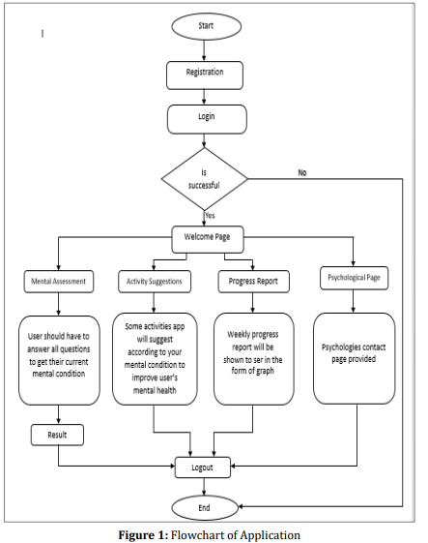
MODELLING

Slide 12
RESULTS
Installation of mobile application needs to be done by the user and psychiatrist.
During answering the questions, the app will identify a user’s mental state and verify whether it has any mental difficulties by gathering data from the user through communication.
After that, data obtained by the test and kept in the database will be examined, and if mental trouble is found, the user will receive an alert and some activity and task will be assigned, and a report will be generated.
In general, the app will be available to all users and will include many feature in addition to mental health analysis, such as daily blogs, motivational boosts, expert advice, exercises, and so on, all of which will assist the user in resolving mental difficulties while also enjoying fun activities and even talking with expert advice.
When the alert is delivered to the psychiatrists, they will review the report and contact that specific user to give therapy that they require.

Slide 13
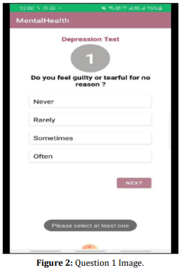
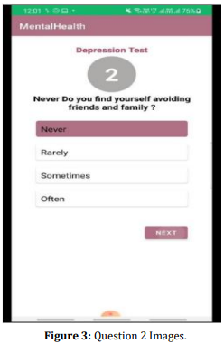
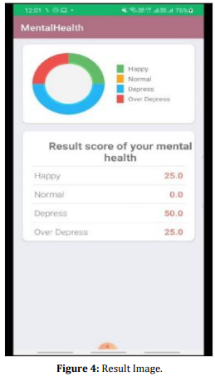
RESULTS
MOBILE APPLICATION

Slide 14
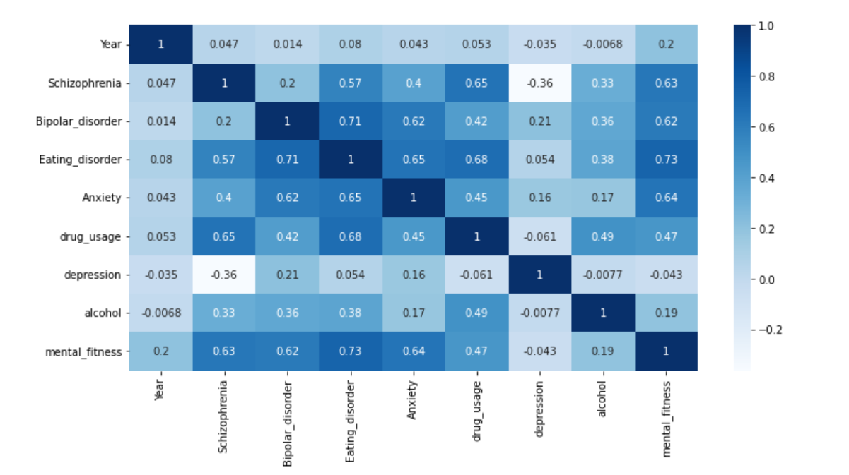
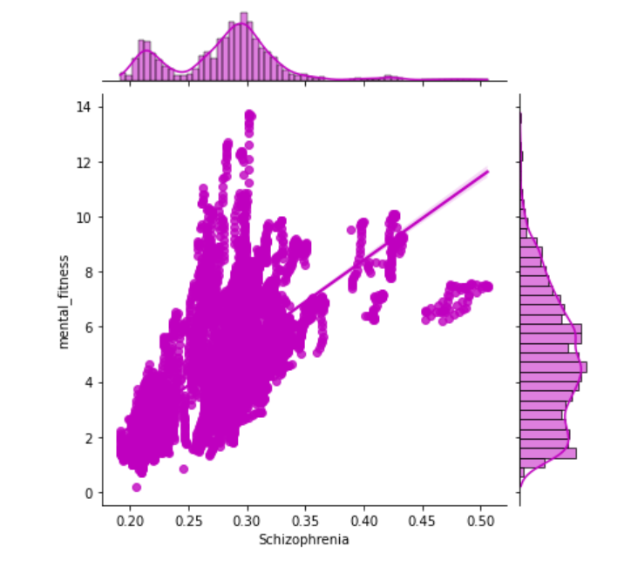
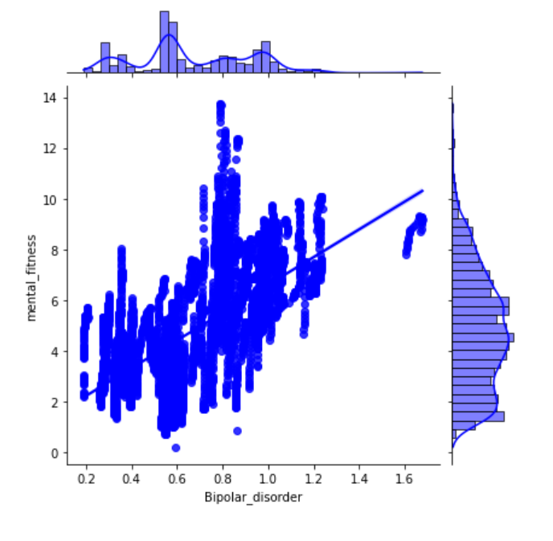
RESULTS
EXPLORATORY ANALYSIS

Slide 15
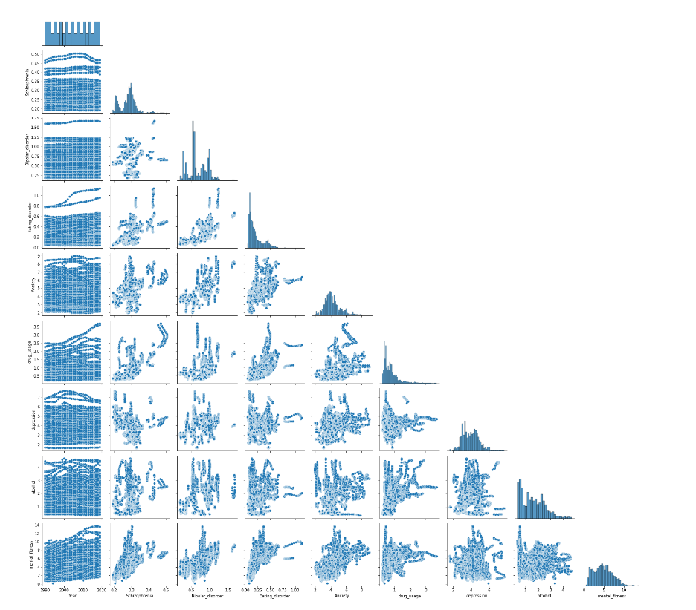
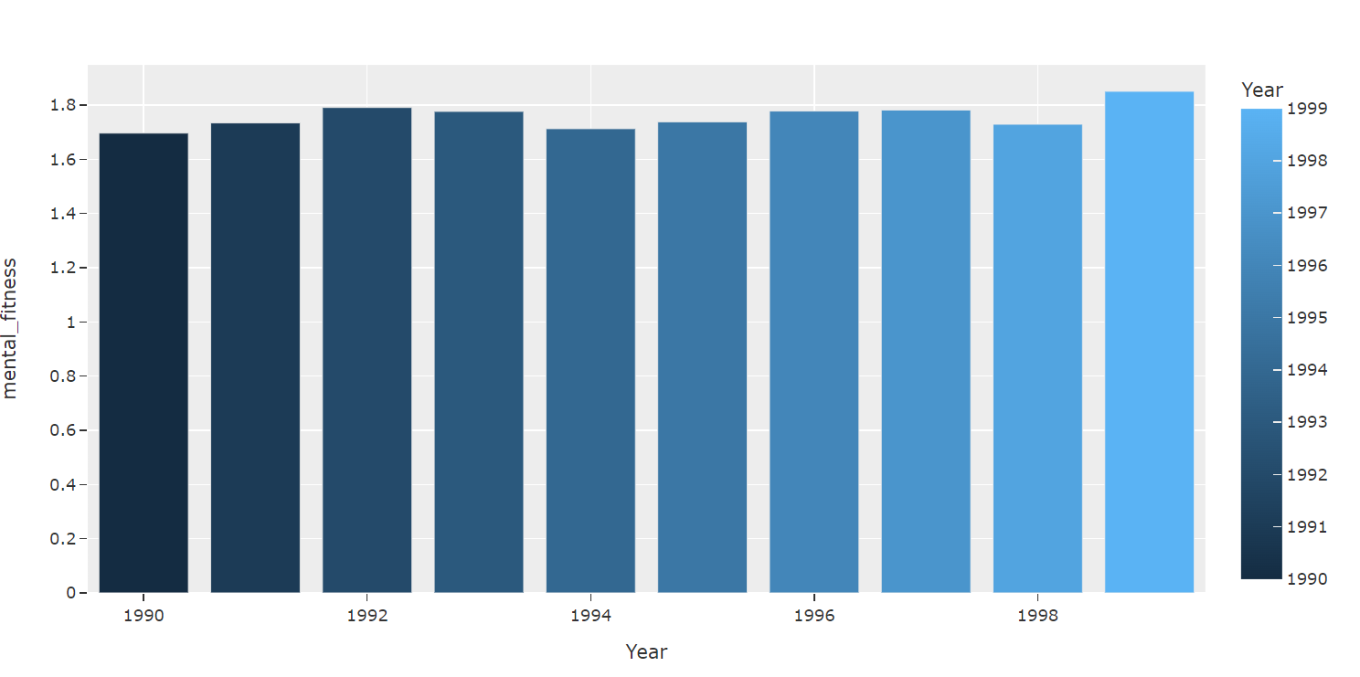
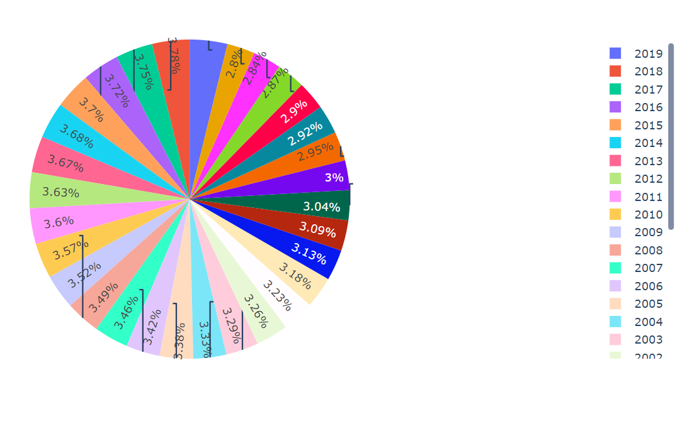
RESULTS
EXPLORATORY ANALYSIS

Slide 16
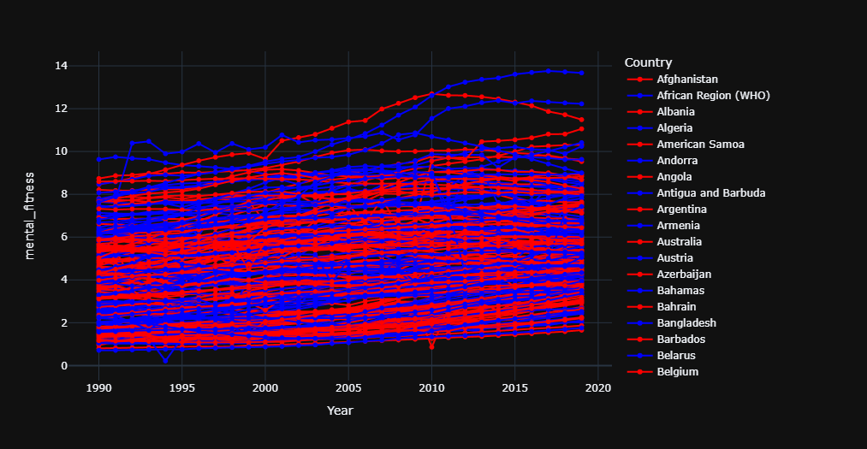
RESULTS
YEARWISE VARIATIONS IN MENTAL FITNESS OF DIFFERENT COUNTRIES

Slide 17
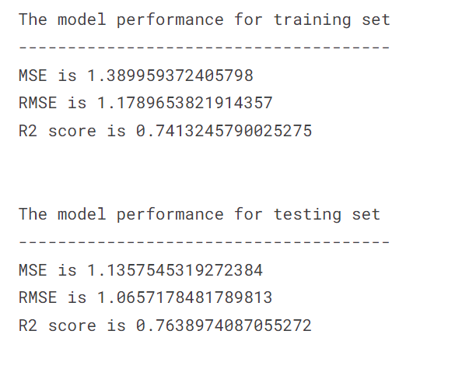
RESULTS
LINEAR REGRESSION

Slide 18
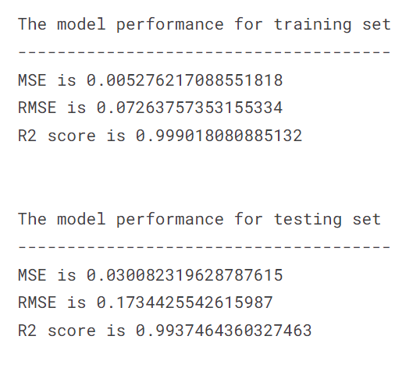
RESULTS
RANDOM FOREST REGRESSOR

Slide 19
LINKS
Code:
https://www.kaggle.com/code/udaykumarjb/ai-mental-fitness-tracker-1
Dataset:
https://www.kaggle.com/datasets/udaykumarjb/mental-fitness-tracker-1
Drive Link:
https://drive.google.com/drive/folders/1ewTnr5aYgetszIEMkDc5YIFH0dE4yaWW?usp=sharing

